Slide 1

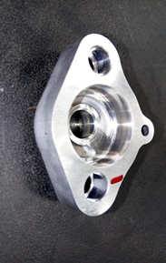
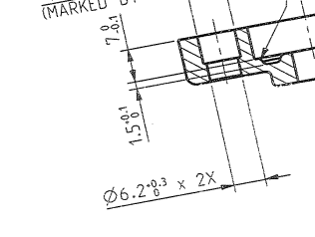
P15
TPM CIRCLE NO :- 01
ACTIVITY
KK
QM
PM
JH
SHE
OT
DM
E&T
KAIZEN IDEA SHEET
TPM CIRCLE NAME: Achiever
LOSS NO. / STEP
DEPT :- MACHINE SHOP
RESULT AREA
P
Q
A
C
D
S
M
B
CELL:- Oil Pump
CELL NAME:- A312 Body
MACHINE / STAGE :- VMC
OPERATION :- Reaming Milling
KAIZEN THEME : To eliminate A312 oil pump body dowel hole unclean
IDEA :- As cast mounting hole tolerance reduced from +0.3 to +0.15 mm
PROBLEM PRESENT STATUS :- A312 oil pump body dowel hole unclean
COUNTERMEASURE:-
1. As cast mounting hole maintained dia. 6.2 +0.15 mm
BENCHMARK
1072 No's
TARGET
0 no
KAIZEN START
07.02.2017
TDC
20.03.2017
KAIZEN FINISH
After correction in tolerance we was taken trial. Total Qty. Machining-550 Qty. All parts OK no unclean patch mark found
TEAM MEMBERS :, Umesh
Pimple, Ganesh Kharmale, D.Y. Pawar
BENEFITS :-
Eliminate in house rejection.
Before
After
KAIZEN SUSTENANCE
WHY - WHY ANALYSIS :-
Why1 :- A312 oil pump body dowel hole unclean
Why2 :- Component get shifted one side during clamping
Why3 :- Gap in between as cast mounting hole & locating pin OD
Why4 :- As cast mounting hole size tolerance is more .(Dia. 6.2 +0.3 mm & Pin OD -6.2 -0.014 mm)
RESULT :-
WHAT TO DO:- Check point added in Sustenance audit check sheet.
HOW TO DO:- Check visually.
FREQUENCY :- Daily
Better
SCOPE & PLAN FOR HORIZONTAL DEPLOYMENT
Sr No | CELL | TDC | RESP. | STATUS
1 | Oil Pump | 20.03.17 | Ganesh Kharmale | In process
2
ROOT CAUSE : As cast mounting hole size tolerance is more .(Dia. 6.2 +0.3 mm & Pin OD -6.2 -0.014 mm)
REGISTRATION NO. & DATE : 07.02.2017
REGISTERED BY :- Sachin Kadnar
MANAGER’S SIGN :- Sandeep Patil

